Slide 1
Effectively support autistic students by understanding the link between emotional regulation and low arousal as part of a whole school approach
Monday 29th April 2019
Gareth D Morewood
Co-Director of Curriculum Support & Specialist Leader of Education,
Priestnall School, Stockport; Honorary Research Fellow, University of Manchester;
Education Advisor, Studio III; Associate Editor, Good Autism Practice Journal
& Vice-Chair SENCo-Forum Advisory Group.

Slide 2
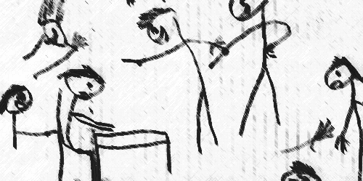
Why can school be such a challenging place for many young people?
Taken from Humphrey & Lewis (2008)

Slide 3
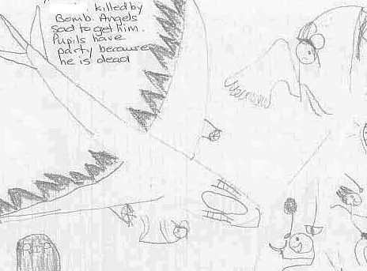
Why can school be such a challenging place for many young people?
Taken from Humphrey & Lewis (2008)

Slide 4
What do parents/carers and young people want?
Appropriate support, without a battle
  “I found that if, as a parent, I had not been prepared to fight for my child, he would not have got where he is now, let alone got the specialised help that we needed. The sooner help is received, the quicker the child can begin to fulfil their potential” [parent] (National Autistic Society, 2011, p.7)
Choice and flexibility
  “The teacher intuitively understood my child and how to teach him. She gave him work that was at his intellectual level, and let him choose what he wanted to do—all of it or some of it.” [parent] (Sciutto et al, 2012, p.184)
To feel listened to
  “I have felt very able to challenge the school” [parent] (National Autistic Society, 2011, p.23)
SENCology blog post Why is co-production so powerful? Learning from research.

Slide 5
What do parents/carers and young people want?
Autism to be viewed as difference, not disorder
  “My brain is different, but I’m not bad” [YP] (National Autistic Society, 2011, p.4)
  “[Autism] is not a disease that must be corrected. It is a different way of thinking that must be taught— differently” [parent] (Sciutto et al, 2012, p.181)
Better understanding of the challenges of school for students with autism
  “Its really hard to go to school. People don’t understand how hard it is. They judge me for doing things I can’t help” [YP] (National Autistic Society, 2011, p.7)
  “The noisier or more larger the group, the more difficult it is” [YP] (Connor, 2000, p.291)
  “Because I am well-behaved in school, I get overlooked when I am requiring help” [YP] (National Autistic Society, 2011, p.27)

Slide 6
What do parents/carers and young people want?
Teachers and school staff to set a positive example
  “You, the teacher, can make a huge difference – positive or negative – in the way other students view a child with autism. As the leader of the classroom, you set the tone. Be careful not to give the others license to bully that child” [parent] (Sciutto et al, 2012, p.182)
Understanding of the individual student and their autism
  “He is a CHILD first… Do not focus on the disability, but rather his tremendous abilities” [parent] (Sciutto et al, 2012, p.180)
  “You met another kid on the spectrum? That’s nice. Here’s another one. Not the same one. Another one” [parent] (Sciutto et al, 2012, p.180)
SENCology blog post Role models help us define by ability, not disability.

Slide 7
What is emotional regulation?
Emotional regulation is a life-long developmental process underlying attention and social engagement, and is essential for optimal social, emotional and communication development and the development of relationships for all children and adults.
Emotional regulation may also be considered from the perspective of changes that occur over short periods of time, even from moment to moment.
Historically there is a gradual moving away from social and behaviourally based approaches and there is now a more eclectic way of working drawing on a range approaches.

Slide 8
Education professionals and parents/carers should bear in mind that autistic children may try to gain control over socially difficult or unpleasant situations which can cause uncontrollable arousal in the child.
The child then often attempts to gain control by presenting in an aggressive manner towards others, trying to evoke typical negative reactions, so that the child knows when and what to expect (Rieffe et al., 2012).
Common terminology referring to extreme negative states includes “meltdown”, “out of control” or “shutdown”.

Slide 9
Developing work on emotional regulation also requires a focus on positive mental health; autistic children may not have the same awareness of the importance of emotions:
  Autistic children may not be aware of the relationship between physical symptoms and emotional arousal
  Autistic children may have a more fragmented understanding of their emotional state and their levels of emotional arousal
  Poor coping strategies can increase the likelihood of depression and anxiety
(Rieffe et al. 2011)
Morewood, G. D. (2019) Understanding Emotional Regulation in the Context of Whole School Inclusive Systems. INCLUVISION Magazine, published by JSS Private School, Dubai.

Slide 10
Taking these implications into consideration it is important to teach all children about their emotions to increase their awareness of their emotional state.
It is also critical to teach children useful and appropriate coping strategies to deal with emotions; not through a ‘behavioural lens’ but as part of a child-centred, metacognative approach.
When one is well-regulated emotionally, he or she is most available for learning and engaging. In contrast, when one is emotionally dysregulated, he or she is less available for learning and engaging.

Slide 11
Regulation & Dysregulation…
In order to understand emotional regulation and dysregulation, it must be viewed on a continuum, from well-regulated states, to mild, moderate and even extreme states of dysregulation.
A person may be able to continue to engage and learn, albeit less effectively so, in mild and moderate states of dysregulation.
However, in extreme states of dysregulation, a person is no longer available for learning and engaging and may have little control over his or her actions.

Slide 12
There are many factors that affect physiological state, including health status, sleep, arousal bias (low or high arousal) and associated biomedical conditions such as food sensitivities, environmental allergies and so forth.
It is also important to consider the person’s emotional state and emotional experience, e.g. whether a person is feeling content, fearful, anxious, joyful and so forth.
The physical expression by a autistic child may not be a display of challenging behaviour, but could be viewed as a positive attempt by the child to self-regulate (Jahromi et al., 2012).

Slide 13
So what to do?
Most importantly; strategies to support positive and effective emotion regulation need to be taught specifically to children (Jahromi et al., 2012).
Difficulties arise for teachers and parents/carers if they cannot recognise that the children are displaying difficulties with emotion regulation, or with a task (Jahromi et al., 2012).
Emotional regulation may also be described in reference to the strategies that a person uses or develops to maintain a well-regulated state.

Slide 14
The notion of Low Arousal…(1)
The Low Arousal Approach is based on the notion that people with challenging behaviour often have trouble regulating affect.
They often react to other´s affects by experiencing and expressing the same affect. Affect is always contagious, but most people learn to differentiate between own and other´s affects early in life. Some people don´t.
They don´t know if an affect they feel is their own or somebody else's. That can result in anger if somebody else is angry and telling off the one who tells you off.

Slide 15
The notion of Low Arousal…(2)
We also know that challenging behaviour often occurs when someone experiences a high intensity of affect.
Nobody fights when they are relaxed and easy-going.
Calm and self-control is connected, and we want the service-user or child to be in control of him- or herself, so that they can cooperate and work with us, in partnership.
Physiological arousal can be strongly linked to the construct of stress (McDonnell et al, 2014).
Arousal and stress are considered to be important in the regulation of emotion (Reich & Zautra, 2002).

Slide 16
The notion of Low Arousal…(3)
Repetitive behaviours have been described as having a dearousing function in some circumstances (Kinsbourne, 1980).
We must use methods that protect the service-user or child and us from an increase in affect intensity, both in the way we talk to and relate to the child or service-user and in our methods concerning challenging and even violent or self-harming behaviour.
The Low Arousal Approach is about creating a caring environment characterised by calm and positive expectations aiming to decrease stress and challenging behaviour.
The methods load heavily on changing staff and parent/carer’s thoughts and conceptions and on body language, physical distance and conflict evaluation.

Slide 17
There are significant parallels to strategies our own research (Morewood, Humphrey & Symes, 2011), which has directly influenced our whole school ‘saturation’ model.
Some of the key messages for consideration in developing an approach schools and communities are:
  an evidence base isn’t always vital; something that works with only 5% of the school population can still be incredibly useful – personalisation
  organisational changes cannot be affected in a zero tolerance policy – a need for flexibility and reasonable adjustments
  you need the appropriate tools to do the job – training and development is essential

Slide 18
We are part of the problem!
The vast a majority of challenging situations are inadvertently triggered by supporters
We are often unaware that we can trigger situations
Reflective practice is a cornerstone of low arousal approaches
Understanding this is a key concept for improving outcomes for young people and their families

Slide 19
Also consider self-regulation…
Self-regulation is emotional regulation achieved independently by an individual.
When effectively utilizing self-regulatory strategies, a person is able to achieve a more optimal state of arousal and emotional well-being.
In typical development self-regulatory strategies become more sophisticated through socialization and experience.
It is important to understand that self-regulatory behaviours vary as to how socially acceptable, conventional and effective they may be.

Slide 20
Also consider mutual-regulation…(1)
Mutual regulation is emotional regulation that occurs in the context of social interaction.
Effective mutual regulatory abilities allow a person to achieve a more regulated emotional state primarily due to the actions or presence of another person or other people.
At more advanced levels of ability, a person may actively seek out mutual regulation by requesting support or assistance from others.

Slide 21
Also consider mutual-regulation…(2)
As with self-regulation, attempts to maintain a well-regulated state through mutual regulation vary along the dimensions noted previously: social acceptability, conventionality and effectiveness.
Examples of less conventional or socially acceptable strategies may include persistent questioning about upcoming events, seeking out particular kinds of sensory input from others through climbing on or “crashing” into others, or verbal or nonverbal expression of refusal or protest in response to demands that may be perceived as threatening and anxiety-provoking.

Slide 22
"When a person is drowning that is not the best time to teach them how to swim."
(David Pitonyak)

Slide 23
What can we do to improve the educational experiences and outcomes of young people with autism?
Agent of change
Developing the school environment
Flexible provision
Direct support and intervention
Policy development and embedding practice
Training and development of staff
Peer education and awareness
Creating a positive ethos
Morewood, G. D., Humphrey, N. & Symes, W. (2011) Mainstreaming autism: making it work. Good Autism Practice Journal 02.12.11, 62-68.

Slide 24
What can we do to improve the educational experiences and outcomes of young people with autism?
Agent of change
Developing the school environment
Flexible provision
Direct support and intervention
Policy development and embedding practice
Training and development of staff
Peer education and awareness
Creating a positive ethos
Morewood, G. D., Humphrey, N. & Symes, W. (2011) Mainstreaming autism: making it work. Good Autism Practice Journal 02.12.11, 62-68.

Slide 25
What can we do to improve the educational experiences and outcomes of young people with autism?
Agent of change
Developing the school environment
Flexible provision
Direct support and intervention
Policy development and embedding practice
Training and development of staff
Peer education and awareness
Creating a positive ethos
Morewood, G. D., Humphrey, N. & Symes, W. (2011) Mainstreaming autism: making it work. Good Autism Practice Journal 02.12.11, 62-68.

Slide 26
What can we do to improve the educational experiences and outcomes of young people with autism?
Agent of change
Developing the school environment
Flexible provision
Direct support and intervention
Policy development and embedding practice
Training and development of staff
Peer education and awareness
Creating a positive ethos
Morewood, G. D., Humphrey, N. & Symes, W. (2011) Mainstreaming autism: making it work. Good Autism Practice Journal 02.12.11, 62-68.

Slide 27
What can we do to improve the educational experiences and outcomes of young people with autism?
Agent of change
Developing the school environment
Flexible provision
Direct support and intervention
Policy development and embedding practice
Training and development of staff
Peer education and awareness
Creating a positive ethos
Morewood, G. D., Humphrey, N. & Symes, W. (2011) Mainstreaming autism: making it work. Good Autism Practice Journal 02.12.11, 62-68.

Slide 28
What can we do to improve the educational experiences and outcomes of young people with autism?
Agent of change
Developing the school environment
Flexible provision
Direct support and intervention
Policy development and embedding practice
Training and development of staff
Peer education and awareness
Creating a positive ethos
Morewood, G. D., Humphrey, N. & Symes, W. (2011) Mainstreaming autism: making it work. Good Autism Practice Journal 02.12.11, 62-68.

Slide 29
What can we do to improve the educational experiences and outcomes of young people with autism?
Agent of change
Developing the school environment
Flexible provision
Direct support and intervention
Policy development and embedding practice
Training and development of staff
Peer education and awareness
Creating a positive ethos
Morewood, G. D., Humphrey, N. & Symes, W. (2011) Mainstreaming autism: making it work. Good Autism Practice Journal 02.12.11, 62-68.

Slide 30
What can we do to improve the educational experiences and outcomes of young people with autism?
Agent of change
Developing the school environment
Flexible provision
Direct support and intervention
Policy development and embedding practice
Training and development of staff
Peer education and awareness
Creating a positive ethos
Morewood, G. D., Humphrey, N. & Symes, W. (2011) Mainstreaming autism: making it work. Good Autism Practice Journal 02.12.11, 62-68.

Slide 31
What can we do to improve the educational experiences and outcomes of young people with autism?
Agent of change
Developing the school environment
Flexible provision
Direct support and intervention
Policy development and embedding practice
Training and development of staff
Peer education and awareness
Creating a positive ethos
Morewood, G. D., Humphrey, N. & Symes, W. (2011) Mainstreaming autism: making it work. Good Autism Practice Journal 02.12.11, 62-68.

Slide 32
What can we do to improve the educational experiences and outcomes of young people with autism?
Agent of change
Developing the school environment
Flexible provision
Direct support and intervention
Policy development and embedding practice
Training and development of staff
Peer education and awareness
Creating a positive ethos
Morewood, G. D., Humphrey, N. & Symes, W. (2011) Mainstreaming autism: making it work. Good Autism Practice Journal 02.12.11, 62-68.

Slide 33
Applying aspects of the ‘triad of impairments’ to the education
system (Humphrey et al, 2015)
  Inflexibility – how can we be more flexible in the way in which we organise our educational provision?
  Social communication – how can we improve communication between the range of stakeholders in autism education in order to improve the educational experiences and outcomes of students?
  Imagination – should we not be more imaginative ourselves in thinking about approaches to teaching and learning?

Slide 34
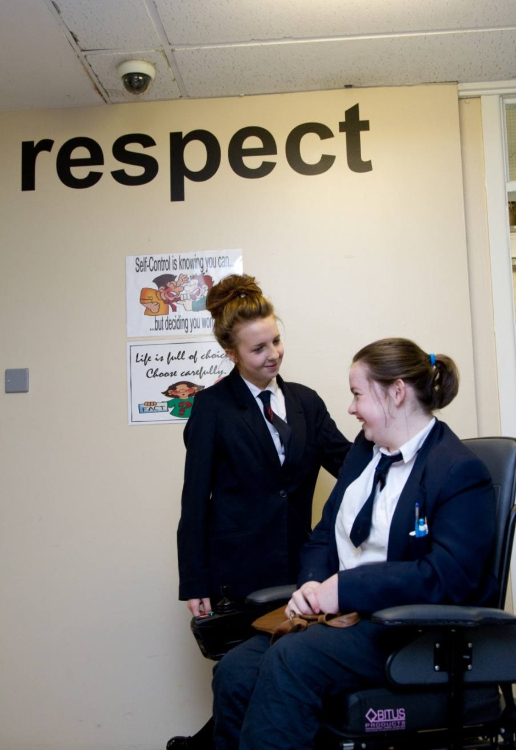
‘The education of the peer group is an essential part of moving towards a truly inclusive community’
Gareth D Morewood (2011)

Slide 35
Ensure clear communication with parents/carers
Keep parents/carers informed
Make sure they know who to contact and how
Provide honest communication – no long-term benefit in providing anything but the truth
Listen to parents/carers – give them time
Try to avoid uncertainty/misinterpretation
MOREWOOD, G. D., & BOND, C. (2012) Understanding Parental confidence in an inclusive high school: a pilot survey. Support for Learning, Vol. 27 No.2, p53-58 Wiley Blackwell Publishing.

Slide 36
“We need schools where difference is valued and where there is less emphasis on conformity and greater focus on harnessing strengths in order to enable all, staff and students alike….to be the best they can become”
Professor Rita Jordan
‘Personalisation NOT Normalisation’
Dr Damian Milton

Slide 37

The ‘Bananarama’ Principle…
It ain’t what you do it’s the way that you do it…
So how do you spend to ‘get results’?
Or, what does the evidence say is a good investment or a poor investment for your students?
It ain’t what you spend but the way that you spend it… what works for one, may not for others!
Quoted from Prof Steve Higgins

Slide 38
Key messages…
Environment is very important
Mirroring and supporting self-regulation is vital
Establishing and maintaining calm, emotionally regulated places and structures in school and at home are key elements
Explicitly understanding and teaching strategies support self-regulation is important – how can you discuss/establish collaborative approaches?
Pre-learning and scheduling in advance help reduce risks and support the individual’s ability to use strategies within context

Slide 39
Educating Persons with Autistic Spectrum Disorder - A Systematic Literature Review
Bond, C., Symes, W., Hebron, J., Humphrey, N., Morewood, G. & Woods, K. (2016) Educational Interventions for children with autistic spectrum disorder – a systematic literature review 2008-2013. School Psychology International, SAGE.

Slide 40
Intervention Rating Scheme (all studies 2008-2013)
4. Most evidence – At least 4 studies providing positive evidence which either includes a positive RCT or quasi experimental study or 6 or more single case experimental studies.
3. Moderate evidence – 3 or more studies providing positive evidence which either includes a positive RCT or QES or 4 or more SCE studies.
2. Some evidence – 2 or more studies providing positive evidence which either includes a positive RCT or QES or 3 or more SCE studies.
1. Little evidence – 1 RCT/ QES or 1 or 2 SCE studies providing positive evidence.

Slide 41
Interventions rated 4 (most evidence) Pre-school
1. Interventions to increase joint attention skills (N=4)
Mostly 1:1 play based/turn taking interventions with an adult (teacher or parent).
2. Comprehensive early interventions (N=10)
Interventions part of holistic learning experience and targeted a range of areas e.g. social skills, behaviour, communication, attention and learning, often in a school setting. Measures sampled a range of areas of development.

Slide 42
Interventions rated 4 (most evidence)
School age
Social
1. Peer mediated interventions in mainstream schools (N=9)
Naturalistic interventions to enable peers to interact more effectively with ASD children (e.g. lunchtime clubs or peers, researcher and child with ASD meeting to collaboratively plan strategies, may include some peer instruction).
2. Multi-component social skills interventions (N=6)
Interventions (e.g. UCLA PEERS, Children’s Friendship Training) included several elements such as a parent group to support social skills/networks and a social skills group and/or social skills training for the young people with ASD.

Slide 43
Interventions rated 4 (most evidence)
School age
Flexibility interventions
3. Behavioural interventions based upon behavioural principles (N=7)
behavioural interventions enabled the development of flexibility and tolerance for change (e.g. multi-element behaviour plans, environmental modification and prompting). Often based on functional analysis of behaviour.

Slide 44
Interventions rated 3 (moderate evidence)
Pre-school
1. Play based interventions (N=3)
1:1 and small group. Interventions focused on teaching play skills or peer mediated play activities.
2. Video modelling to develop communication skills (N=4)
Use of video of desired behaviour (or video as prompt) to encourage behaviour such as use of PECS or sharing information about the school day.

Slide 45
Interventions rated 3 (moderate evidence)
School age
1. Social initiation training (N=4)
Pivotal Response Training or use of scripts to teach child
with ASD to initiate social interaction.
2. Computer assisted emotion recognition interventions (N=3)
using computer programmes and video modelling to improve emotion recognition.
3. Picture Exchange Communication System in special school (N=3)
behaviourally based communication system beginning with exchange of symbols for desired objects.
Notes:
.

Slide 46
Interventions rated 3 (moderate evidence)
School age
4. Discrete skills training using behavioural approaches (N=4)*
Usually 1:1 skills training (e.g. model-lead-test and direct instruction) to support acquisition of discrete skills such as letter/number recognition.
5. Narrative interventions (N=5)
1:1, interventions such as social stories and power cards used to prompt particular behaviours.
(* and pre-school)

Slide 47
Interventions rated 2 (some evidence)
No specific pre-school interventions identified in this category.
School age
Lego therapy® – small group intervention with clear roles to enable group construction of Lego models.
Behavioural interventions to develop communication skills (special school) – 1:1 structured interventions using behavioural strategies to encourage or shape communication.
School age comprehensive intervention programmes - coaching teachers to plan individualised strategies for children in special schools and classes and measurement of whether goals set for children were achieved.

Slide 48
A vital message…
‘No amount of intervention can make up for poor quality-first inclusive teaching.’

Slide 49
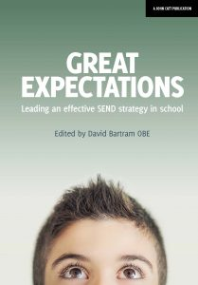
Autism, Education & Emotional Regulation
A unique one day course for schools and educational settings
www.studio3.org/innovations
Corporate Responsibility
Morewood, G. D. (2018) in Bartram, D. Great Expectations: leading an effective SEND strategy in school. John Catt Publications.

Slide 50
MEDICAL MODEL THINKING | SOCIAL MODEL THINKING
Person is faulty | Person is valued
Diagnosis | Strengths and needs defined by self and others
Labelling | Identify barriers and develop solutions
Impairment becomes the focus of attention | Outcome based programme designed
Assessment, monitoring, programmes of therapy imposed | Resources are made available to ordinary services
Segregation and alternative services | Disability Equality Training for All
Ordinary needs put on hold | Encourage social relationships
Re-entry if normal enough OR Permanent Exclusion | Diversity welcomed and disabled person is Included
Society remains unchanged | Society evolves
(Adapted from Micheline Mason 1994 & R. Rieser 2005)

Slide 51
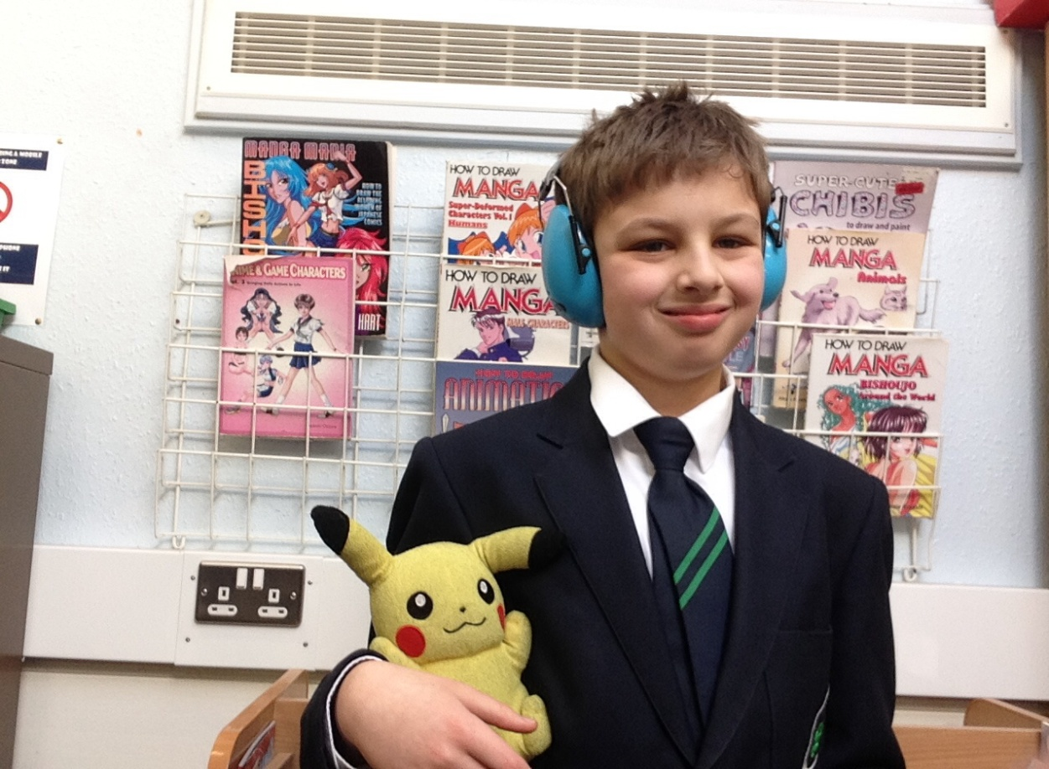
“Priestnall is really good because they have many autistic students and they understand us. I think I will have a great time at Priestnall because they know how to deal with me and support me. Social time is great as I get to hang out with other students who like to share my interests.”
Bobby, aged 12

Slide 52
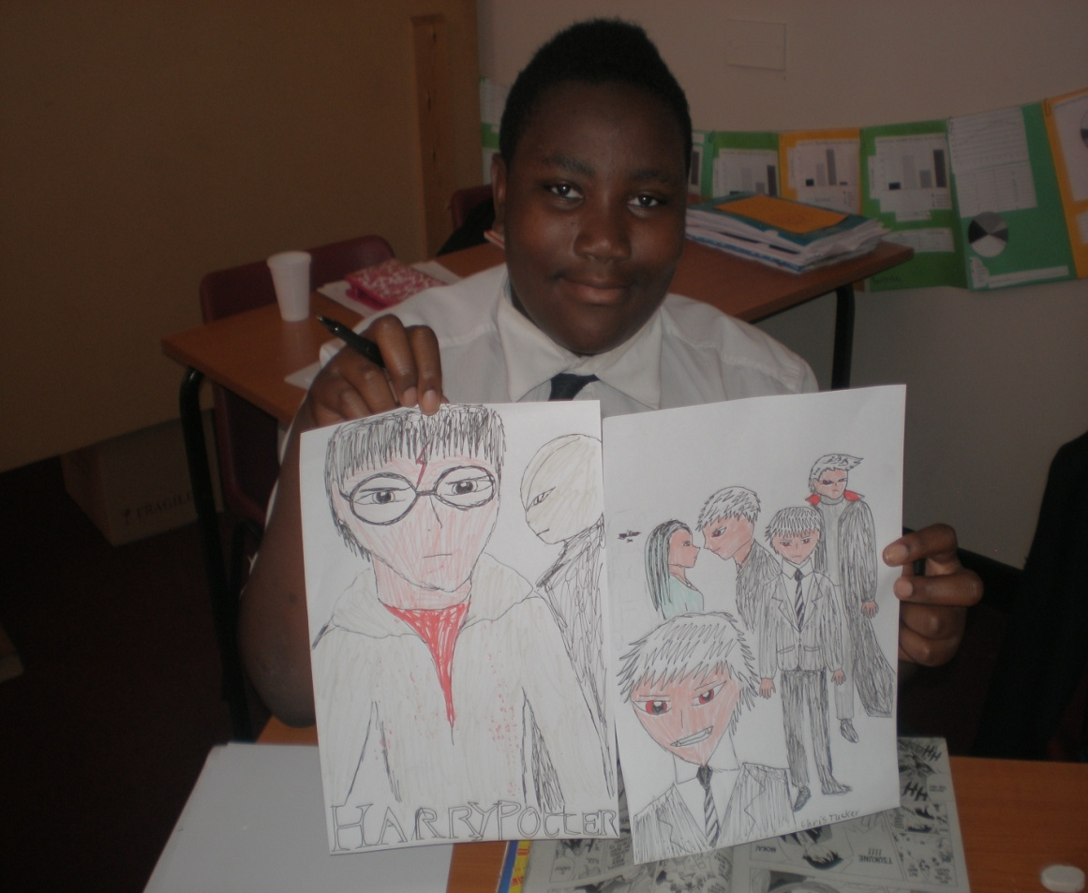
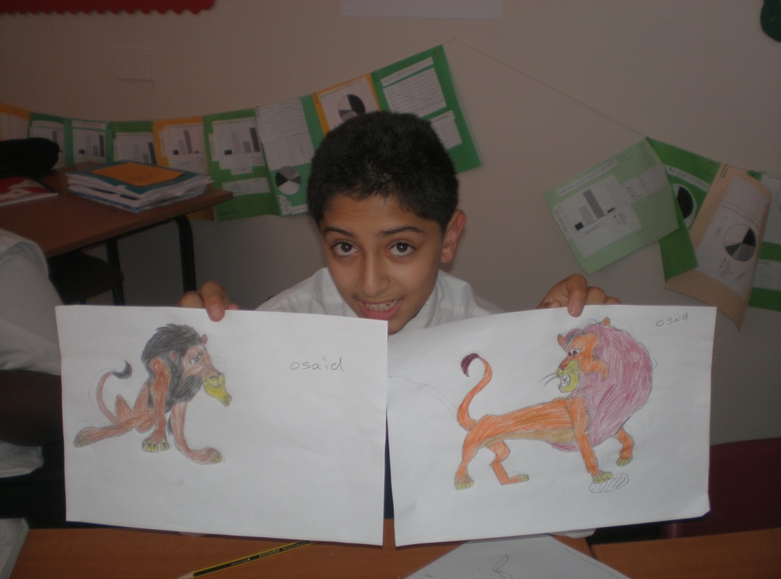
Chris, now aged 19
(pictured aged 13)
Osaid, now aged 21
(pictured aged 13)

Slide 53
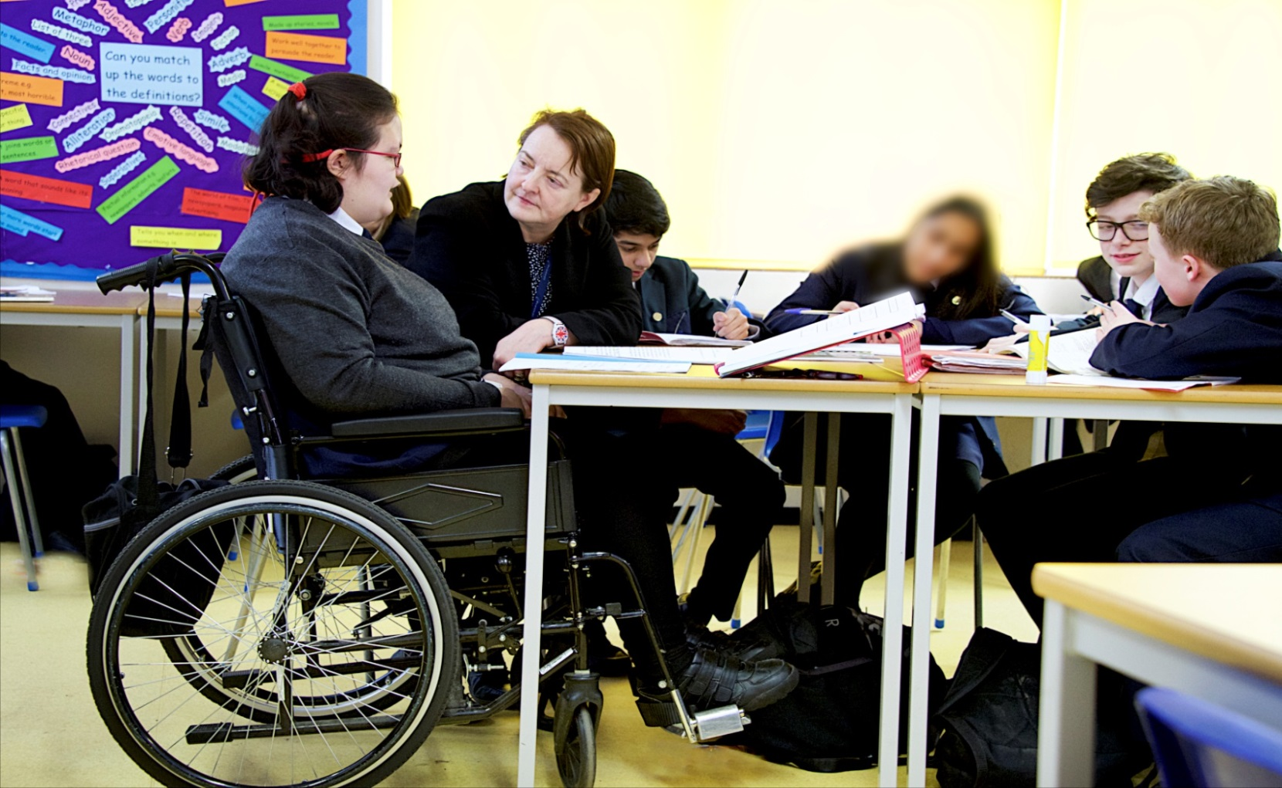
“I get to do everything my friends do, just that sometimes I have things changed a little so I can join in properly.” Lola, aged 15

Slide 54
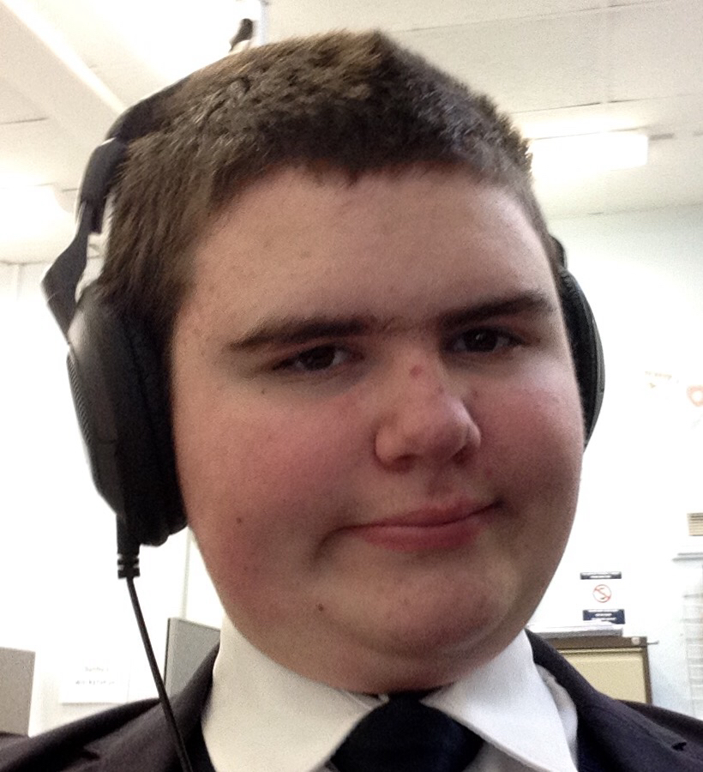
“At first it was very difficult for me at school but now I like to take on challenges and I like that here there are safe rooms for you to go to. I am good at maths.”
Jack, aged 15

Slide 55
Later in 2019…
Morewood, G., Tomlinson, C. & Bond, C. (in press, 2019) Meeting the needs of autistic girls at secondary school. In Hebron, J. & Bond, C (Eds). Educating girls on the autism spectrum: developing an integrated approach. London. Jessica Kingsley.

Slide 57
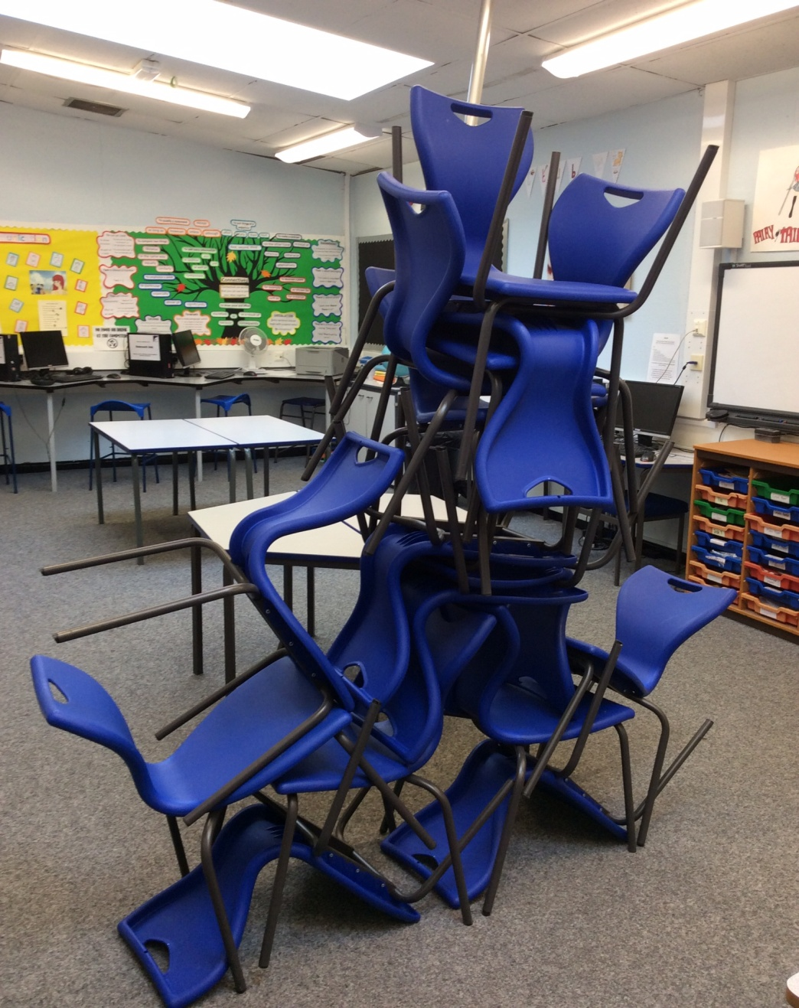

Slide 58
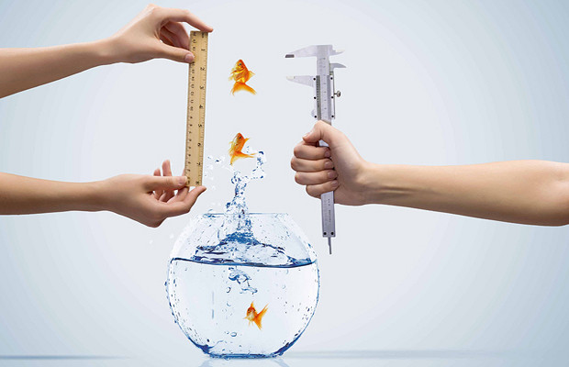

Slide 59


Slide 60
Gareth D Morewood
www.gdmorewood.com
@gdmorewood
www.studio3.org
@studioIII

